Slide 1
Simple does it
Weakly Supervised Instance and Semantic Segmentation
Anna Khoreva | Rodrigo Benenson|
Jan Hosang | Matthias Hein | Bernt Schiele

Slide 2
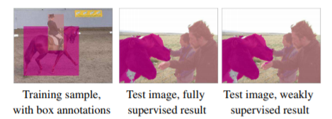
Abstract
Semantic labelling & instance segmentation → costly annotations.
Approach → Use weak supervision i.e. use bounding box annotations.
Results:
Overall, our weak supervision approach reaches ∼95% of the quality of the fully supervised model, both for semantic labelling and instance segmentation.

Slide 3
Introduction
ConvNets are the de facto technique for pattern recognition problems in computer vision.
However, they need a lot of training data to achieve good results.
Getting enough training data is expensive.
Getting annotations for spatial masks is very expensive.
Box annotations are more pervasive, cheaper and easier to define.

Slide 4
Introduction
The problem of weak supervision is viewed as an issue of input label noise.
Recursive training is explored as a de-noising strategy.
ConvNet predictions of the previous training round are used as supervision for the next training round.

Slide 5
Introduction Main contributions:-
Recursive training of ConvNets for weakly supervised semantic labelling: how to reach good results, limitations of approach. Recursive training is explored as a de-noising strategy.
State of the art quality can be reached in single training round by properly using GrabCut like techniques to generate training labels from given bounding boxes, instead of modifying the segmentation ConvNet training procedure or using recursive training.
Results:
Training with bounding boxes only. Using Pascal VOC12 and VOC12+COCO training data: comparable accuracy is achieved using a fully supervised regime.

Slide 6
Related work
BoxSup: [J. Dai, K. He, and J. Sun: Exploiting bounding boxes to supervise convolutional networks for semantic segmentation] : Recursive training procedure, where ConvNet is trained under supervision of segment object proposals & the updated network in turn improves the segments used for training.
WSSL: [G. Papandreou, L. Chen, K. Murphy, and A. L.Yuille. Weakly- and semi-supervised learning of a DCNN for semantic image segmentation]: Expectation maximization algorithm with a bias to enable the network to estimate the foreground regions.

Slide 7
Related work
We propose → better results can be obtained without modifying the training procedure (compared to fully supervised case) by carefully generating input labels for training from the bounding box annotations.
Instance segmentation: Object proposals that generate segments can be used for instance segmentation.
Given a BB (selected by a detector): GrabCut variants can be used to obtain an instance segmentation.
To enable end-end training of detection & segmentation: train ConvNets for instance segmentations.

Slide 8
Related work
DeepMask: Reference implementation.
DeepLabV2 (Orig. for semantic segmentation): Repurposed for instance segmentation.
From boxes to semantic labels
Goal: High quality semantic labelling from object bounding box annotations.

Slide 9
Cues
C1 Background: Since BBs are exhaustive, pixels not covered by box: background.
C2 Object extent: Assuming a prior → object shapes, the box gives info on the expected object area. Employ this size info during training.
C3 Objectness: Additional object priors → spatial continuity & contrasting boundary with the background.

Slide 10

Box baselines
Given: annotated BB & class label → Label all pixels inside box with such given class.
If 2 boxes overlap, assume smaller → in front.
Any pixel not in boxes → labelled as background.
These labels are used to train a segmentation network with the standard training procedure.
We employ: DeepLabv1 approach.

Slide 11
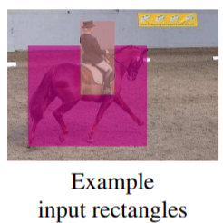
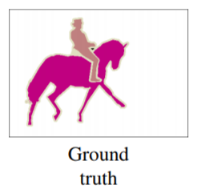
Recursive training
The result of the resulting model inspires us to:
A recursive training procedure, where these new labels are fed in as ground truth for a second training round. We name this recursive training approach Naive.

Slide 12
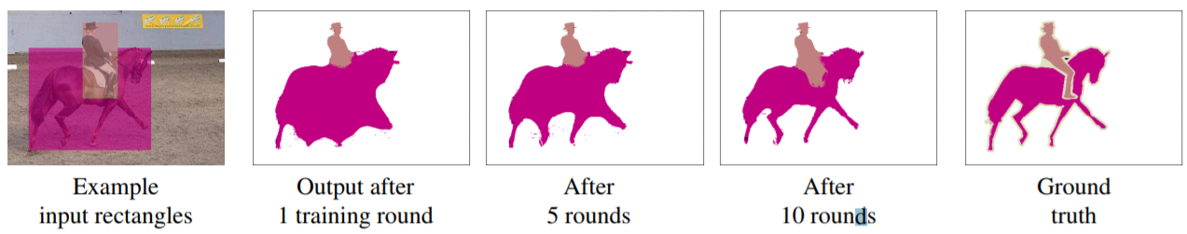
Recursive training
The recursive training is enhanced by de-noising the convent outputs.
We improve the labels using three stages:
1. Any pixel outside the box annotations is reset to background label (cue C1).
2. If area of segment is too small compared to its corresponding bounding box (e.g. IoU < 50%) then the box area is reset to its initial label (fed in the 1st round). This enforces minimal area (cue C2).
3. Filter n/w output to better respect the object boundaries. (We use DenseCRF with the DeepLabv1 parameters).

Slide 13
Recursive training
Ignore regions:
Box^{i}: 2nd variant.
Instead of using filled rectangles as initial labels fill up 20% inner region & leave the remaining inner area of the bounding boxes as ignored regions.
Following cues C2 & C3 20% of the inner box region higher chances of overlapping with the corresponding object, reducing noise in the generated input labels.

Slide 14
Box-driven segments
Getting initial guess of the object segments
Noisy outputs of classic CV + GrabCut + boosting object proposals → ConvNet training.
Output object segments are noisy, but more precise than simple rectangles → provide improved results.
1 training round enough to reach good quality.

Slide 15
GrabCut baselines
GrabCut: Technique to estimate an object segment from its bounding box.
GrabCut+: HED boundaries are used as a pairwise term instead of RGB color difference.
Similar to Box^{i} → consider GrabCut+^{i:} trades-off recall for higher precision.
For each annotated box → ~150 GrabCut+ outputs.
If 70% segments: foreground → pixel: box object class
If 20% segments: foreground → pixel: background
Else: ignore

Slide 16
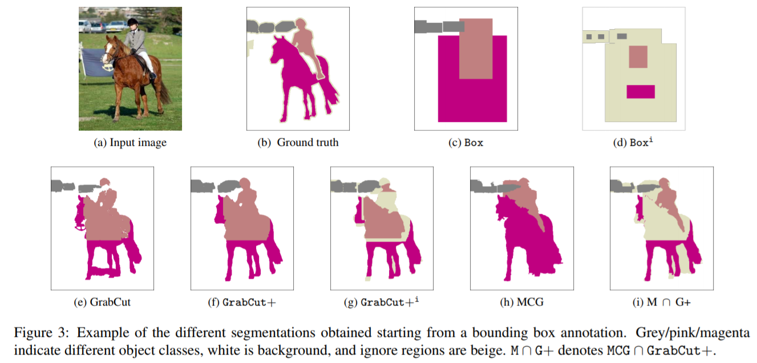
Box baselines’ & Box driven segments’ results

Slide 17
GrabCut baselines
The perturbed GrabCut+ outputs are generated by jittering the box co-ordinates (±5%) as well as the size of the outer background region considered by GrabCut (from 10% to 60%).
Adding objectness
Attempt to better incorporate object shape priors by using segment proposals.
Segment proposal techniques are designed to generate group of likely object segmentations for incorporating as many “objectness” priors as useful (cue C3).

Slide 18
Adding objectness
We use state of the art proposals → MCG: Multiscale combinatorial grouping for image segmentation and object proposal generation.
Final stage: MCG algo → includes a ranking based on decision forest trained over the Pascal VOC 2012 dataset.
Ranking is NOT used for segment selection. All unranked generated segments are used.
Given a box annotation, we pick the highest overlapping proposal as a corresponding segment.

Slide 19
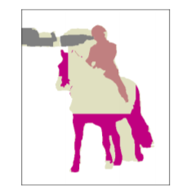
MCG ∩ GrabCut+
MCG segment proposals are used to supplement GrabCut+. Inside the annotated boxes, if MCG ∩ GrabCut+: foreground, else: ignore.
This approach is called: M ∩ G+. This is an improved version of GrabCut+^{i}.

Slide 20
Differences with related research
Our Approach
BoxSup
Keeps the training procedure unmodified and simply generates input labels.
Also uses ignore regions.
Uses lesser epochs for training.
They modify the training procedure so as to denoise intermediate outputs by randomly selecting high overlap proposals.
Does not use the ignore regions concept.
Uses more epochs for training.

Slide 21
Semantic labelling results
Experimental setup:
Datasets:
Evaluation done on Pascal VOC12 segmentation benchmark: 20 foreground object classes & 1 background class.
Segmentation part of VOC12: 1464 training, 1449 validation, and 1456 test images. Augmented set of training images: 10582 images.
In some of our experiments, we use additional training images from the COCO dataset. We only consider images from any of the 20 Pascal classes and only objects with a bounding box area larger than 200 pixels. After this filtering, 99310 images remain (from training and validation sets), which are added to our training set.

Slide 22
Semantic labelling results
Experimental setup:
Datasets:
When using COCO data, we first pre-train on COCO and then fine-tune over the Pascal VOC12 training set.
All of the COCO and Pascal training images come with semantic labelling annotations (for fully supervised case) and BB annotations (for weakly supervised case).
Evaluations:
We use the “comp6” evaluation protocol. Performance: averaged pixel IoU across 21 classes. Most of the results are shown on the validation set. Final results are shown on the test set & compared with the other state of the art models.

Slide 23
Semantic labelling results
Experimental setup:
Implementation details:
N/W: DeepLab-LargeFOV network: same train & test parameters as Semantic image segmentation with deep convolutional nets and fully connected crfs.
The model is initialized from a VGG16 network pre-trained on ImageNet. We use a mini-batch of 30 images for SGD and initial learning rate of 0.001, which is divided by 10 after a 2k/20k iterations (for Pascal/COCO).
At test time DenseCRF is applied. Our network and post-processing are comparable to the ones used in BoxSup & Weakly- and semi-supervised learning of a dcnn for semantic image segmentation.

Slide 24
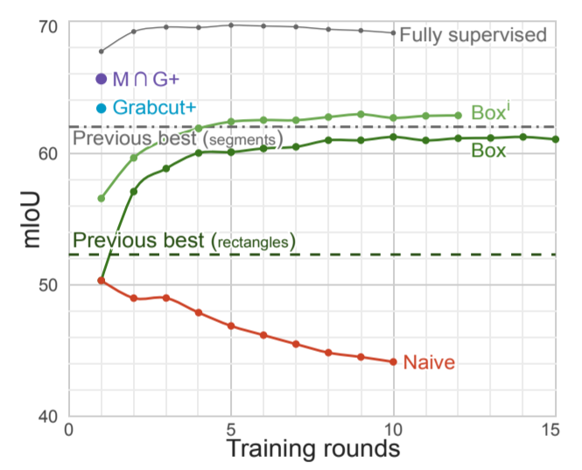
Main results

Slide 25
DeepLabV1 approach
N/W: DeepLab-LargeFOV network: same train & test parameters as Semantic image segmentation with deep convolutional nets and fully connected crfs.
The model is initialized from a VGG16 network pre-trained on ImageNet. We use a mini-batch of 30 images for SGD and initial learning rate of 0.001, which is divided by 10 after a 2k/20k iterations (for Pascal/COCO).
At test time DenseCRF is applied. Our network and post-processing are comparable to the ones used in BoxSup & Weakly- and semi-supervised learning of a dcnn for semantic image segmentation.
Here the approach is simple and fixed. In all our experiments we use a fixed training and test time procedure. Across experiments we only change the input training data that the networks gets to see.
For our best variant M ∩ G+ the data generation step for VOC12 takes ~6h, running in parallel (12 cores) on a GPU machine. Our total training time is ~16h, including DeepLab training (~10h). In comparison BoxSup training takes ~27h.

